Slide 1
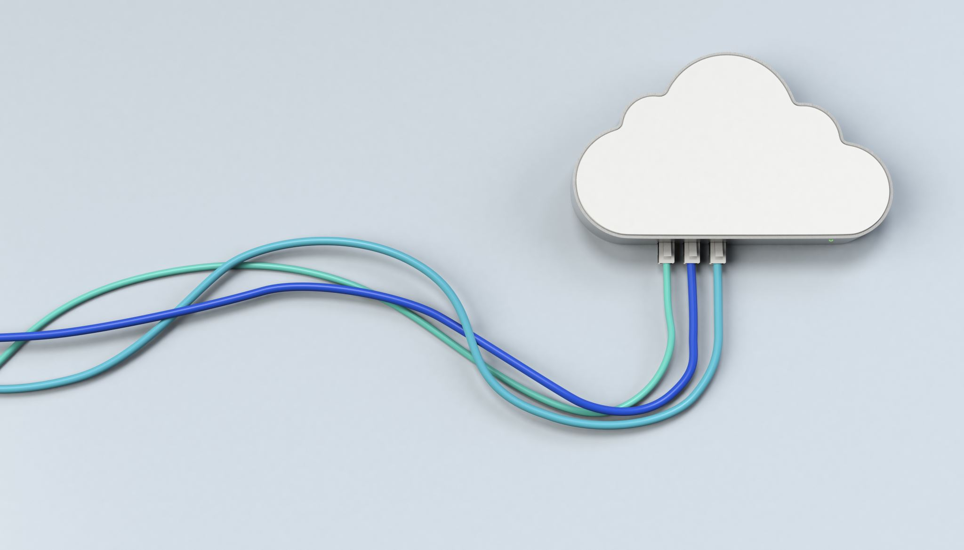
CHAPTER 5 Cloud Computing SERVICES
|Cloud Computing

Slide 2
Cloud Computing Services Overview
Introduction: Cloud computing offers scalable and on-demand computing resources over the Internet.
Deployment Models:
Public Cloud: Services are delivered over the public Internet and shared across multiple organizations.
Private Cloud: Services are maintained on a private network, offering more control and security.
Hybrid Cloud: Combines public and private clouds, allowing data and applications to be shared.
Community Cloud: Shared infrastructure for a specific community of organizations with common concerns.
Service Models:
Infrastructure-as-a-Service (IaaS)
Platform-as-a-Service (PaaS)
Software-as-a-Service (SaaS)

Slide 3
Service Delivery Models
Infrastructure-as-a-Service (IaaS):
Description: Provides virtualized computing resources over the Internet.
Benefits: Scalability, cost-efficiency, and flexibility in managing computing resources.
Platform-as-a-Service (PaaS):
Description: Provides a platform allowing customers to develop, run, and manage applications without dealing with the underlying infrastructure.
Benefits: Simplifies application development, reduces infrastructure management, and supports collaborative development.
Software-as-a-Service (SaaS):
Description: Delivers software applications over the Internet on a subscription basis.
Benefits: No need for installation, automatic updates, and accessibility from any device with an Internet connection.

Slide 4
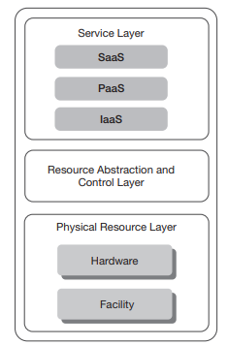
Infrastructure-as-a-Service (IaaS)
Definition: Delivers virtualized hardware resources such as servers, storage, and networking.
Features:
Virtual Resources: Virtual processors, memory, storage, and networking.
Cost Model: Pay-as-you-go for the resources used.
Examples: Amazon EC2, Google Compute Engine, Microsoft Azure VMs.

Slide 5
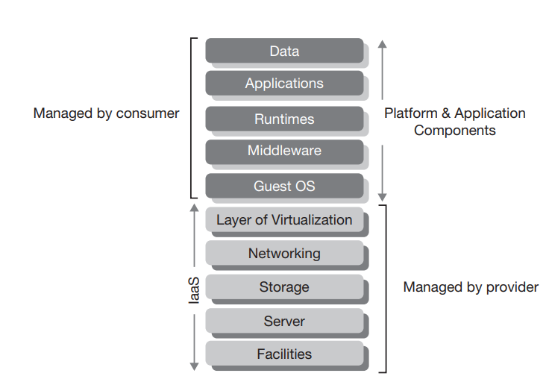
IaaS Component Stack
Components:
Managed by Provider: Hardware, networking, storage.
Managed by Consumer: Applications, operating systems, runtime environments.
Benefits: Outsources management of physical hardware while allowing customization of virtual resources.

Slide 6
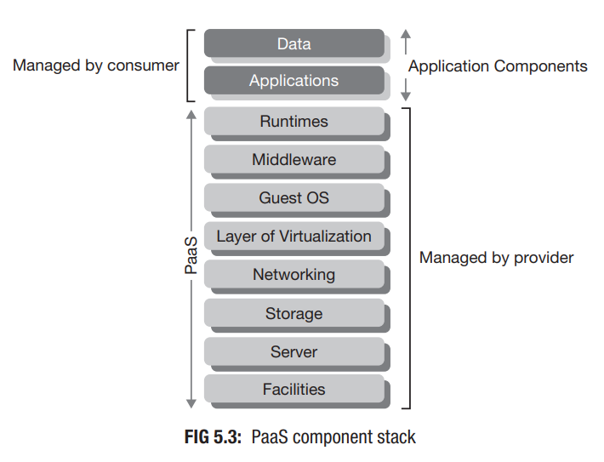
Platform-as-a-Service (PaaS)
Definition: Provides a platform for developers to build, deploy, and manage applications without managing the underlying infrastructure.
Features:
Integrated Development Environment: Tools and services for application development.
Managed Environment: Includes operating systems, middleware, and runtime libraries.
Examples: Google App Engine, Microsoft Azure App Services, Heroku.

Slide 7
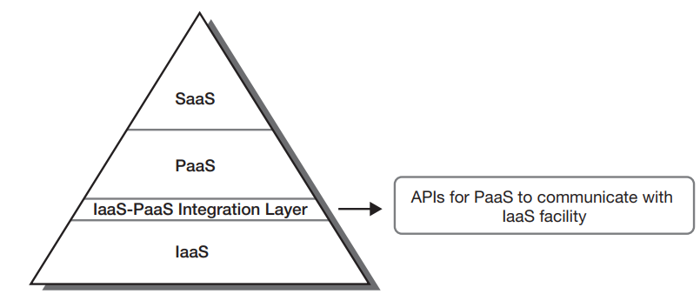
PaaS–IaaS Integration
Integration Mechanism: PaaS utilizes APIs provided by IaaS to access and manage underlying infrastructure resources.
Benefits: Simplifies application development and deployment by abstracting infrastructure management.
Example: Google App Engine uses Google Cloud’s IaaS resources for scalable infrastructure.

Slide 8
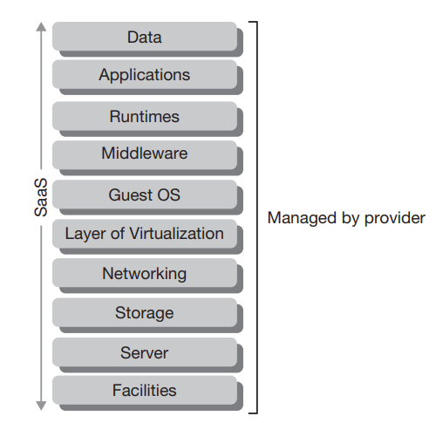
Software-as-a-Service (SaaS)
Definition: Provides software applications over the Internet without the need for local installation.
Features:
Accessibility: Available from any device with Internet access.
Cost Model: Subscription-based, often with a pay-as-you-go model.
Examples: Salesforce, Microsoft Office 365, Google Workspace.

Slide 9
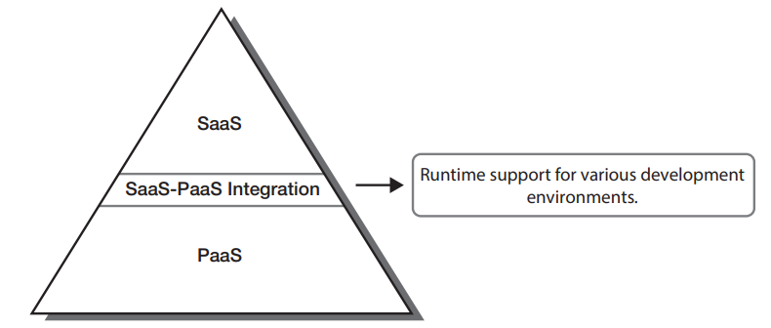
SaaS–PaaS Integration
Integration Mechanism: SaaS applications leverage PaaS environments to operate efficiently.
Runtime Support: PaaS provides the necessary runtime environments (Java, .NET, Python) for SaaS applications.
Example: SaaS applications running on Microsoft Azure use Azure’s PaaS services.

Slide 10
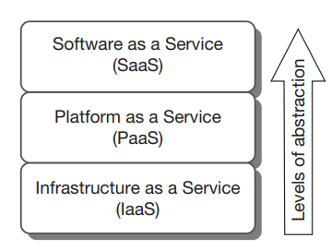
Levels of Service Abstraction
Abstraction Levels:
IaaS: Provides virtualized hardware resources.
PaaS: Provides a development platform on top of IaaS.
SaaS: Delivers end-user applications on top of PaaS.

Slide 11
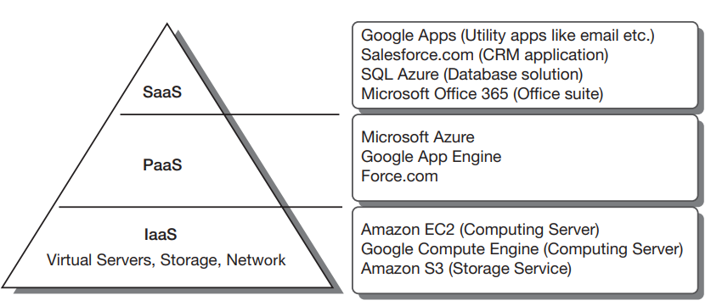
The SPI Model
Definition: The SPI model combines SaaS, PaaS, and IaaS into a layered architecture where each layer builds upon the previous one.
Benefits: Ensures a structured approach to delivering cloud services.

Slide 12
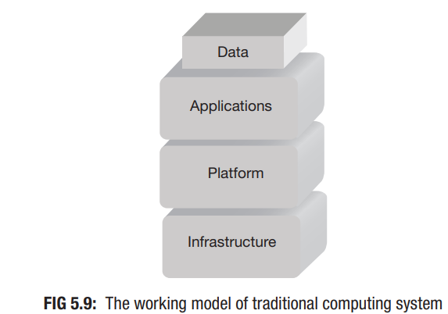
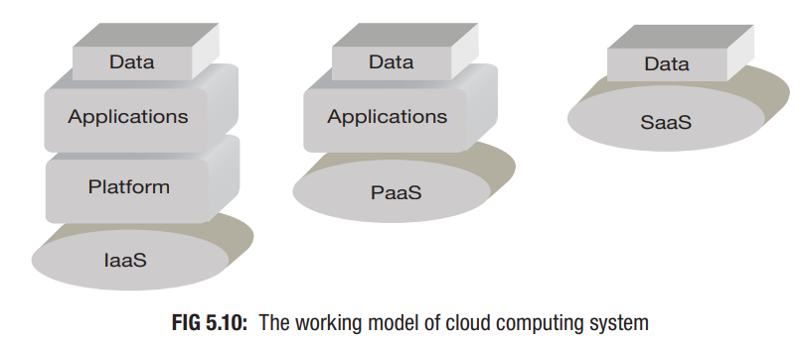
Traditional vs Cloud Computing Models
Traditional Model:
Responsibilities: Managing all layers (hardware, platform, applications) by the user.
Diagram: Figure 5.9 showing traditional computing stack.
Cloud Model:
Responsibilities: Varies by service model (IaaS, PaaS, SaaS).
Diagram: Figure 5.10 showing cloud computing stack with reduced responsibilities for users.

Slide 13
Software-as-a-Service (SaaS) vs. Application Service Provider (ASP)
SaaS: Software delivered over the web with cloud computing attributes
Core Attributes:
Rapid elasticity
On-demand self-service
Measured service
ASP (1990s): Hosted software via the web
Key Points:
Similar to traditional models
Not inherently multi-tenant or scalable

Slide 14
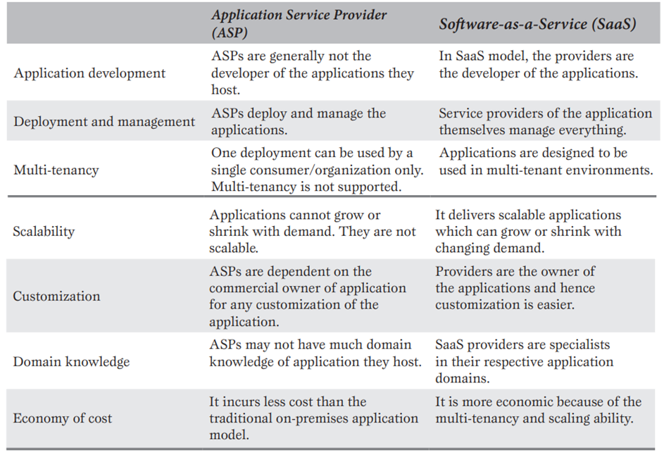
Key Differences Between ASP and SaaS

Slide 15
Advantages of SaaS Compared to Traditional Models
Licensing:
SaaS uses a subscription model, eliminating the need for upfront software licensing fees. This contrasts with traditional software, which typically requires a one-time license purchase.
Risks of Software Acquisition:
SaaS mitigates risks associated with deploying large-scale applications such as ERP or CRM systems by managing the complexity of deployment, resources, and expertise required.
Business Focus:
By shifting responsibilities like upgrades and performance monitoring to the provider, businesses can focus on their core goals and high-value activities.

Slide 16
Salesforce.com and Force.com
Salesforce.com:
Pioneering SaaS provider, launched in 1999, offering a hosted CRM system.
Enabled customization and extension of its services through its PaaS platform, Force.com.
Force.com:
Introduced as a PaaS solution by Salesforce.com for users to develop custom functionalities and extend the core CRM offerings.

Slide 17
XaaS (Anything-as-a-Service) and Its Categories
Definition: A general term encompassing various cloud services beyond the core SPI model.
Categories:
Security Management-as-a-Service (SMaaS)
Identity Management-as-a-Service (IDaaS)
Storage-as-a-Service (STaaS)
Database-as-a-Service (DBaaS)
Backup-as-a-Service (BaaS)
Compliance-as-a-Service (CaaS)
Desktop-as-a-Service (DaaS)
Monitoring-as-a-Service (MaaS)

Slide 18
Security Management-as-a-Service (SMaaS)
Purpose: Manages security tasks like virus updates, logs, and audits.
Examples: Cisco, McAfee, Symantec

Slide 19
Identity Management-as-a-Service (IDaaS)
Purpose: Handles authentication, authorization, and access control.
Features: Federated identity, single sign-on.
Examples: Symplified, Ping Identity

Slide 20
Storage-as-a-Service (STaaS)
Purpose: Provides cloud storage on a pay-per-use basis.
Benefits: Cost-effective, disaster recovery.
Examples: Amazon S3, Rackspace

Slide 21
Database-as-a-Service (DBaaS)
Purpose: Manages database provisioning, configuration, and maintenance.
Features: On-demand and self-service.
Examples: Amazon RDS, Microsoft SQL Azure

Slide 22
Backup-as-a-Service (BaaS)
Purpose: Offers data backup and recovery solutions.
Benefits: Specialized expertise, cost-effective.

Slide 23
Compliance-as-a-Service (CaaS)
Purpose: Ensures adherence to laws and regulations.
Role: Acts as an intermediary for regulatory compliance.
Features: Specialized in industry-specific regulations.

Slide 24
Desktop-as-a-Service (DaaS)
Purpose: Delivers personalized desktop environments via the cloud.
Benefits: Consistent desktop experience across devices.
Examples: Amazon WorkSpaces, Citrix, Desktone

Slide 25
Monitoring-as-a-Service (MaaS)
Purpose: Tracks performance and functionality of cloud services.
Benefits: Helps in performance optimization and issue resolution.

Slide 26
Open Cloud Services
Focus: Primarily for private cloud environments.
Examples:
Eucalyptus: IaaS for hybrid cloud; compatible with Amazon Cloud.
OpenNebula: IaaS for public, private, and hybrid clouds.
Nebula: Developed by NASA; IaaS for large datasets.
Nimbus: IaaS for scientific communities; compatible with Amazon Cloud.
OpenStack: Open-source IaaS; supported by a wide range of contributors.
Apache VCL: Remote access to computing resources.
Apache CloudStack: IaaS with support for AWS APIs.
Enomaly ECP: Early open-source IaaS solution; now commercially available.

Slide 27
Open Cloud Services
Eucalyptus:
Description: Open-source IaaS for building private or hybrid clouds.
Key Features: Compatible with Amazon Cloud, supports hybrid cloud environments.
History: Developed at the University of California, commercialized by Eucalyptus Systems in 2009.
OpenNebula:
Description: Open-source IaaS for public, private, and hybrid clouds.
Key Features: Compatibility with Amazon Cloud, integrated into Ubuntu and Red Hat distributions.
History: Originated as a research project in 2005, managed by C12G Labs.
Nebula:
Description: Open-source IaaS developed by NASA for handling large datasets.
Key Features: Provides compute and storage facilities.
History: Released in 2008, commercialized by Nebula Inc. in 2013.

Slide 28
Open Cloud Services
Nimbus:
Description: Open-source IaaS developed for scientific computing.
Key Features: Compatible with Amazon Cloud services.
History: Developed at the University of Chicago, licensed under Apache License 2.
OpenStack:
Description: Open-source IaaS solution launched by Rackspace and NASA.
Key Features: Supports both public and private clouds, over 200 contributing companies.
History: Initiated in 2010, governed by the OpenStack Foundation.
Apache VCL:
Description: Open-source platform for remote computing access.
Key Features: Built with Linux, Apache, MySQL, and PHP.
History: Started by NC State University, contributed to Apache Software Foundation in 2008.

Slide 29
Open Cloud Services
Apache CloudStack:
Description: Open-source IaaS solution for cloud management.
Key Features: Supports AWS APIs, facilitates hybrid cloud deployment.
History: Acquired by Citrix in 2011, contributed to Apache Software Foundation.
Enomaly ECP (Elastic Computing Platform):
Description: Early IaaS solution for building cloud environments.
Key Features: Initially open-source, later offered commercially.
History: Developed by Enomaly Inc., launched in 2009.

